Slide 1
Image Classification
Anuriya Raveendran
DA & DS

Slide 2
Introduction
Objective: Develop a deep learning model to classify road signs using Convolutional Neural Networks (CNN).
Importance: Helps in autonomous driving, traffic sign recognition, and improving road safety.

Slide 3
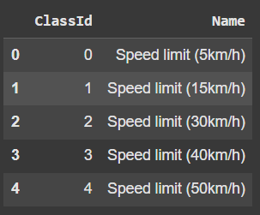
Data Details
Images: Road sign images for classification.
DATA folder - 743
TEST folder - 285
Classes: 30 categories (e.g., Speed Limit, No Entry, Stop Sign).
Lebals (CSV file) : Labels classid and names

Slide 4
Data Preprocessing
Extracting images and labels
Resizing Images: Standardized to 64x64 pixels.
Normalization: Pixel values scaled between 0-1.
Label Encoding: Converted labels to integers/one-hot vectors.
Data Augmentation: Applied rotation, flipping, scaling, and cropping to improve model generalization.
Splitting the data into training, validation and test data.

Slide 5
CNN Architecture
Input Layer: 64x64x3 RGB Image.
Convolutional Layers: Extract features from images.
Pooling Layers: Downsample feature maps.
Fully Connected Layers: Dense layers for classification.
Activation Functions: ReLU (hidden layers), Softmax (output layer).

Slide 6
Model Training
Optimizer Used: Adam
Loss Function: Categorical Cross-Entropy
Training Strategy:
Batch Size = 32
Epochs = 20
Early Stopping : prevent overfitting

Slide 7
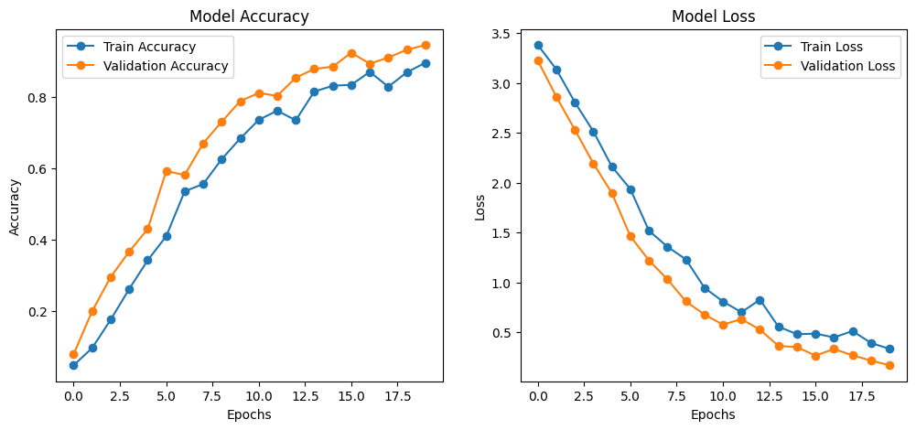
Model Performance

Slide 8
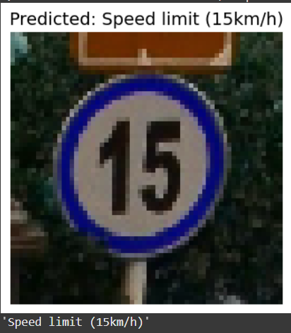
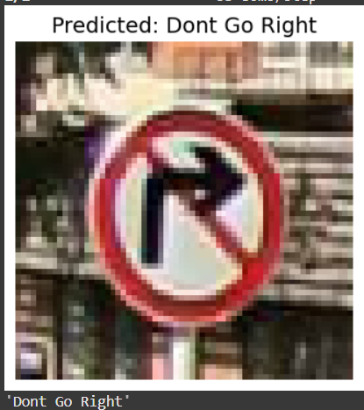
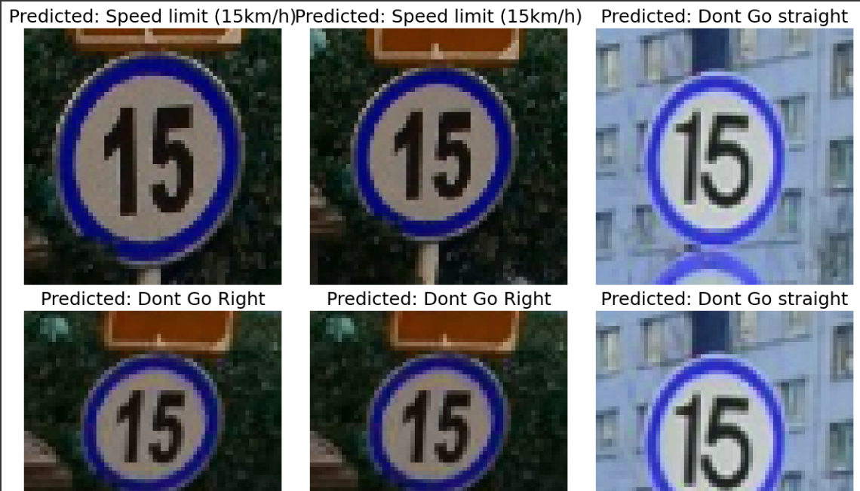
Test Results

Slide 9
Future Enhancements
Expand dataset with more diverse images.
Implement Transfer Learning (e.g., ResNet, VGG16).
Deploy model in mobile apps or embedded systems.
Improve real-time classification with optimized models.

Slide 10
Conclusion
Summary: Successfully built and evaluated a CNN model for road sign classification.
Key Takeaways:
CNNs effectively classify road signs.
Data preprocessing and augmentation improve performance.
Hyperparameter tuning optimizes accuracy.

Slide 11

Thank you

